Slide 1
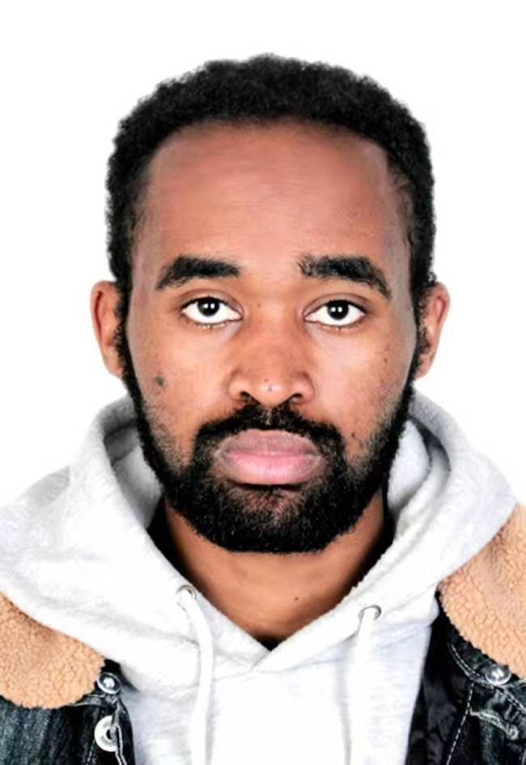
Name Deboch Eyob Abera
school Information and communication Engineering
Research Direction Machine learning and Artificial intelligence
Thesis Title Image fusion based on the deep learning
Supervisor Associate professor Jin Qi

Slide 2
Content
Introduction
Purpose of implementation
Goal
Different Methods
Implementation Plan
Research plans and Expected result

Slide 3
Introduction
Image fusion
Definition
Image fusion is part of DIP which combines information from Multiple input according to the salient property of each pixel, form one better informative output
Objective
Fusion of Infrared and visible image based deep learning
Image fusion technology applied areas
medical image fusion^{[1]}
multi-focus image fusion^{[2]}
remote sensing image fusion^{[3]}
multi-exposure image fusion^{[4]}
visible and infrared image fusion^{[5]}
Goal
The goal of image fusion is to produce a final image that is more accurate and informative than the individual source images by combining data from multiple sensors in parallel.
The deep fusion of infrared and visible images was the primary focus of this research. Infrared and visible images have good complementarity; thus, infrared and visible image fusion methods are extensively used in military, target detection, pattern recognition, RGBT tracking and other applications.

Slide 4
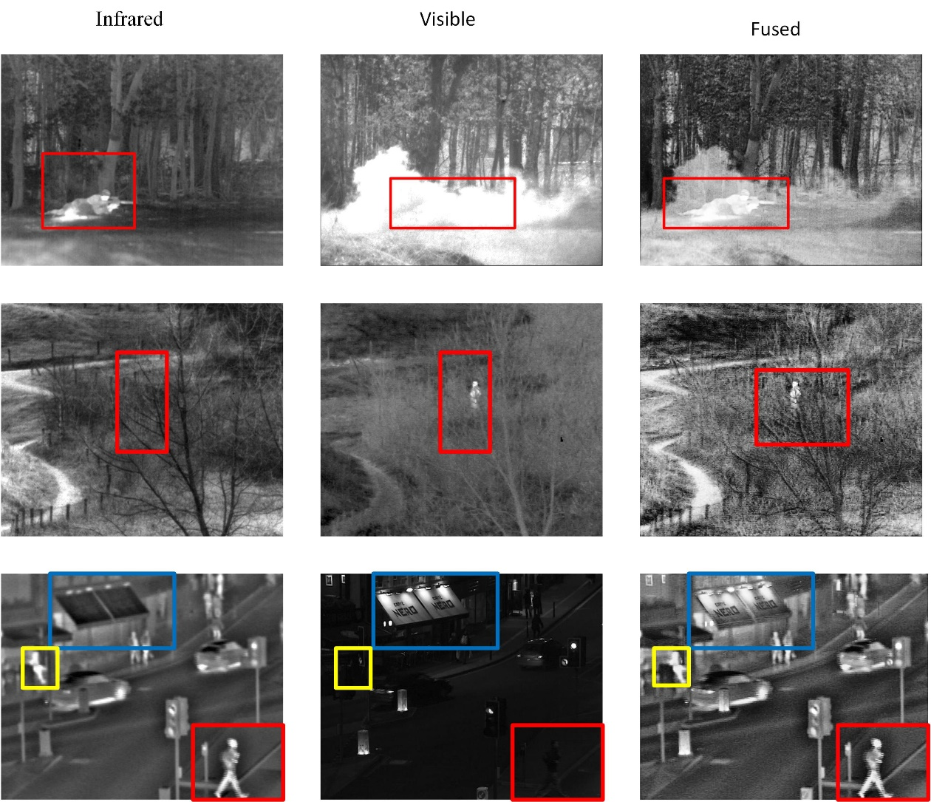
Infrared and visible image fusion
IR
VIS
Fused
VIS
IR
Fused
Visible Image
Visible images can provide texture details with high spatial resolution and definition in a manner consistent with the human visual system.
Get all information from Visible image during night time, low illumination and thick fog/smoke conditions are difficult
Infrared Image
Can distinguish targets from their backgrounds based on thermal radiation information in all day/night conditions
Can not be preferred by the human visual system because it loss special detailed
Has unnatural visual quality.
Therefore, it is desirable to fuse these two types of images, which can combine the advantages of thermal radiation information in infrared images and detailed texture information in visible image.

Slide 5
Purpose of implementation
Due to the excellent characteristics of fused images, the fusion of infrared and visible images has many applications in practice, such as object tracking, target detection in military, medical diagnosis, remote sensing monitoring, etc
Object tracking
due to the limitation of the single mode representation, these tracking methods are not robust. Specifically, the quality of visible images depends on the imaging environment, which means the performance of target tracking is not guaranteed at night or in poor lighting conditions. Similarly, infrared images lack textures and have a poor scene stereoscopic sense, that are also unreliable in certain situations
Target detection in military
Because of poor light condition, fog weather or haze present it is difficult to detect target from only visible image as well as due to loss of texture information of infrared image it’s desirable use fusion of infrared and visible image for target detection by combining or integrating complementary or useful information from source images.
Medical diagnosis
Computed tomography (CT) imaging is effective on implants and bones, whereas magnetic resonance (MR) imaging is effective on soft tissues with anatomical information. To obtain the necessary data for exact clinical analysis, surgeons frequently require combinational analysis of different medical imaging data, which are taken by multiple modalities.

Slide 6
Goal….
General Objective
Get a satisfactory result from the fusion of infrared and visible image by using deep learning
Specific objective
Preprocessing: collecting and preparing dataset
Modeling: design standardized model to explore a fusion algorithm a better effect
Result: Get effective fusion of infrared and visible image
Method Evaluation: Show proposed method is better than another existing method

Slide 7
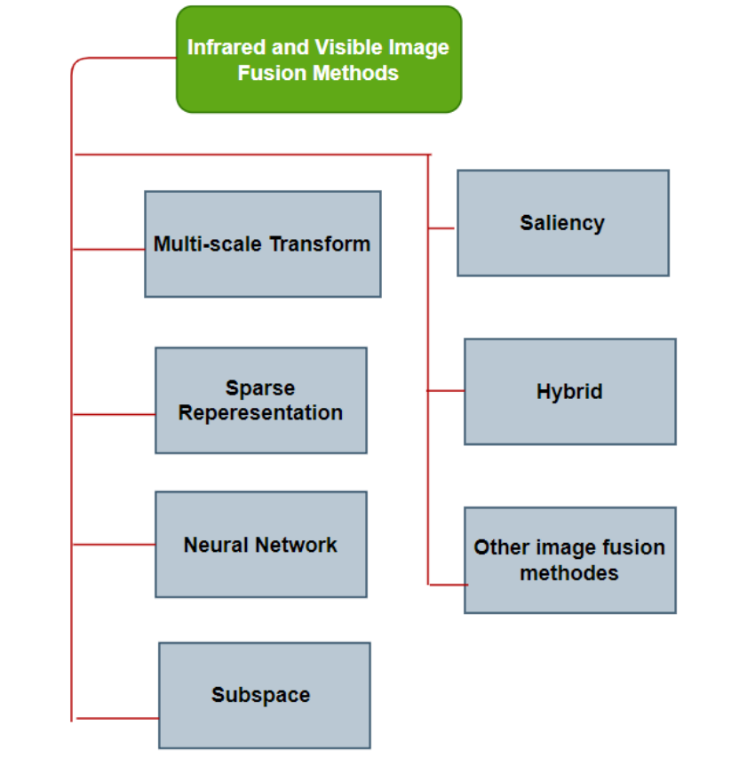
Survey of IVIF methods
IVIF methods and applications: A survey by Jiayi Ma
Using deep learning we can automatically extract feature according to the silence property of given image without manual intervention.
IVIF Techniques Based on Deep Learning: A Review by Changqi Sun
Survey of IVIF in deep learning
Deep learning method has become an active topic in the field of image fusion in the last three years, many deep learning-based fusion methods have been proposed and gradually formed a critical branch.
In terms of the adopted deep architecture, these deep learning-based fusion strategies can be divided into
convolution neural network (CNN)-based
autoencoder (AE)-based, and
generative adversarial network (GAN)-based methods.

Slide 8
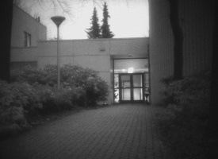
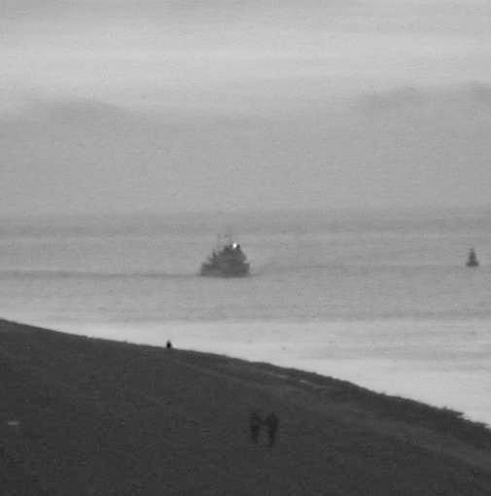
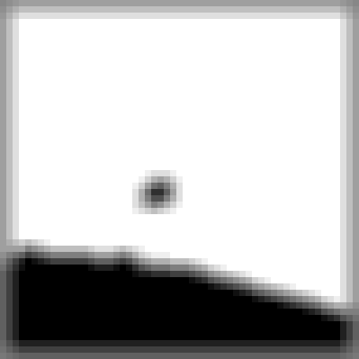
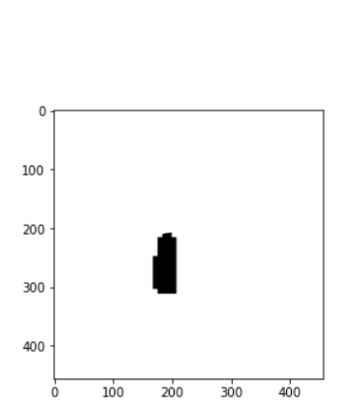
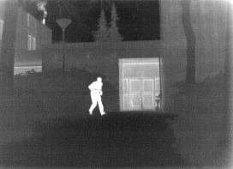
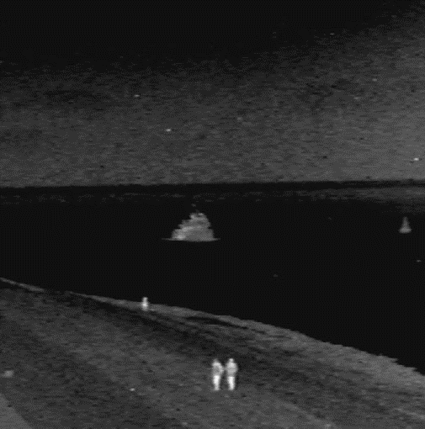
Implementation plan for CNN based
The plan is using deep learning methods; generate weight map in order to fuse weight map with infrared and visible image.
Weight map Generation
Weight map Generation
Pre-trained
Pre-trained

Slide 9
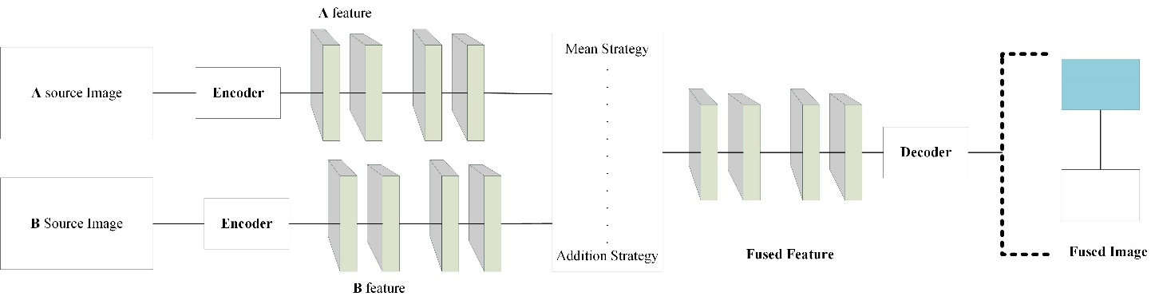
Implementation plan for AE based
The encoder is dedicated to extracting effective features from the input image, while the decoder is to reconstruct the input image from the encoded features

Slide 10
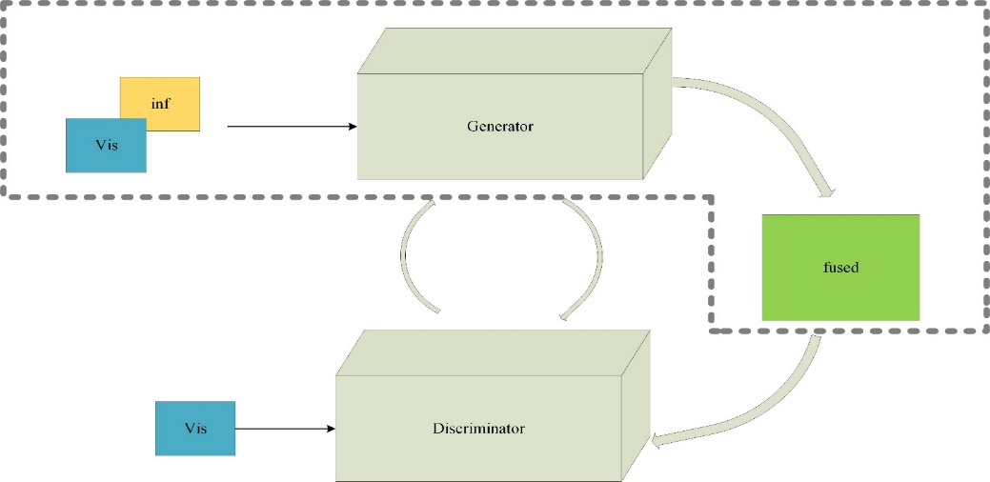
Implementation plan for GAN based
The GAN methods are currently the most popular in the infrared and visible image fusion, which are able to fulfill feature extraction, feature fusion and image reconstruction in an implicit manner.
Generally, the GAN methods rely on two types of loss functions, namely content loss and adversarial loss. The content loss is similar to that in the CNN methods, which is used to initially fuse source images, while the adversarial loss further constrains the tendency of information fusion.

Slide 11
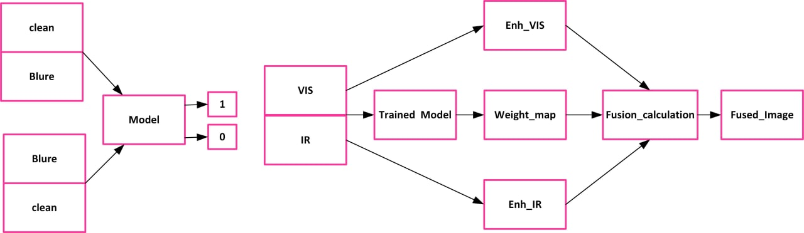
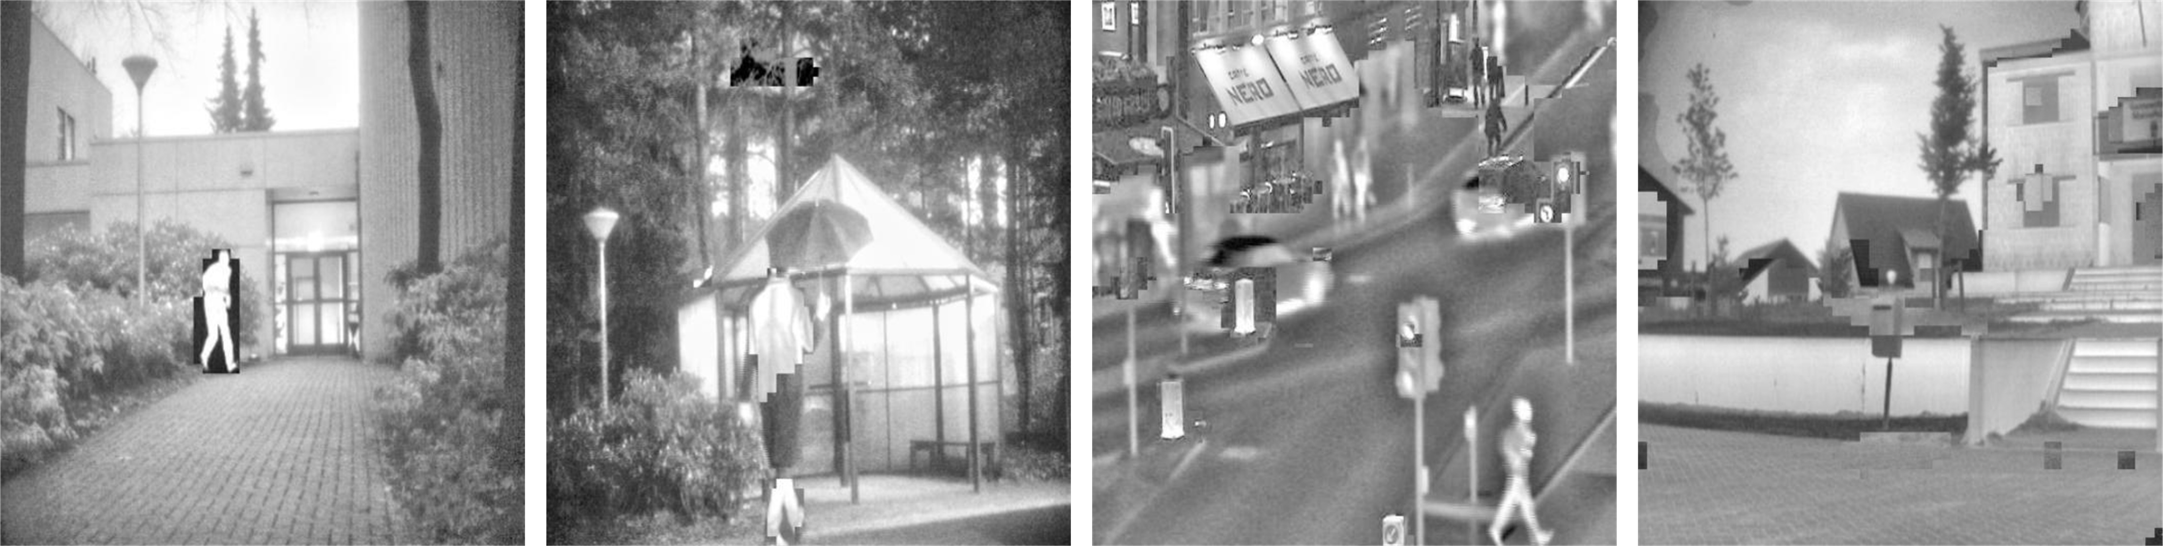
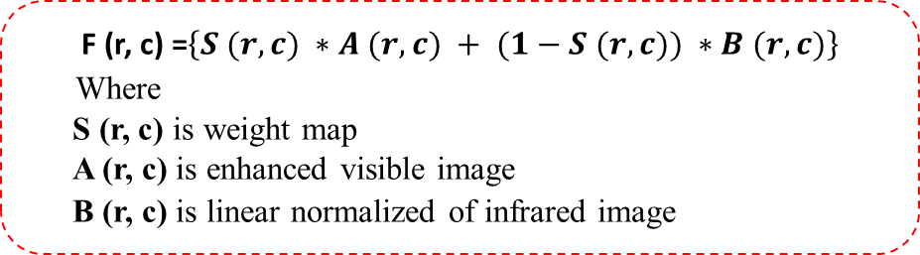
Proposed method
The proposed methodology has three main part:
1, Model Training:
2, Using pre-trained model generate weighted map automatically, according to the salience property of each pixel in source image
3, Fuse weight map with the enhanced infrared and visible Image. Then, finally got fused image
F (r, c) =$\left\{S (r, c) ∗A (r, c) + (1−S (r, c)) ∗B (r, c)\right\}$
Where
S (r, c) is weight map
A (r, c) is enhanced visible image
B (r, c) is linear normalized of infrared image,

Slide 12
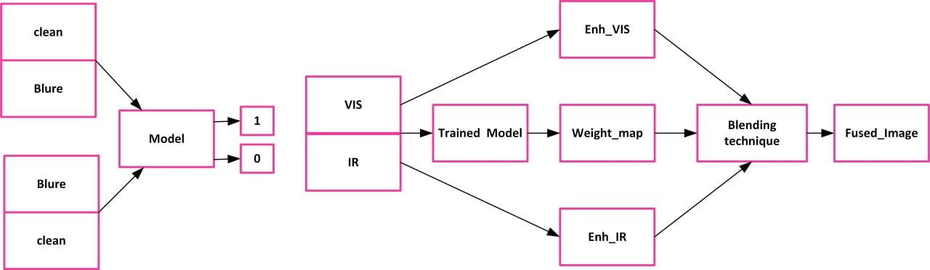
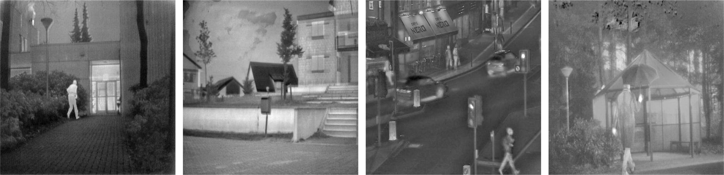
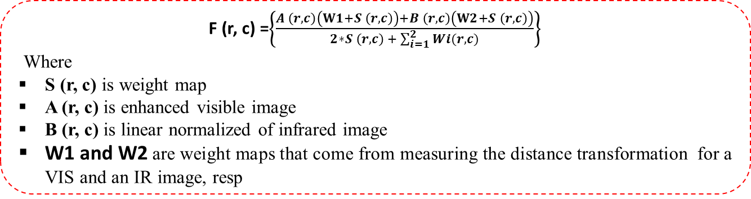
Proposed method
The proposed methodology has three main part:
1, Model Training:
2, Using pre-trained model generate weighted map automatically, according to the salience property of each pixel in source image
3, Fuse weight map with the enhanced infrared and visible Image. Then, finally got fused image
F (r, c) =$\left\{\frac{A \left(r, c\right)\left(W1+S \left(r, c\right)\right)+B \left(r, c\right)\left(W2+S \left(r, c\right)\right)}{2∗S \left(r, c\right) + \sum_{i=1}^{2}{Wi(r,c)}}\right\}$
Where
S (r, c) is weight map
A (r, c) is enhanced visible image
B (r, c) is linear normalized of infrared image,
W1 and W2 are weight maps that come from measuring the distance transformation for a VIS and an IR image, resp

Slide 13
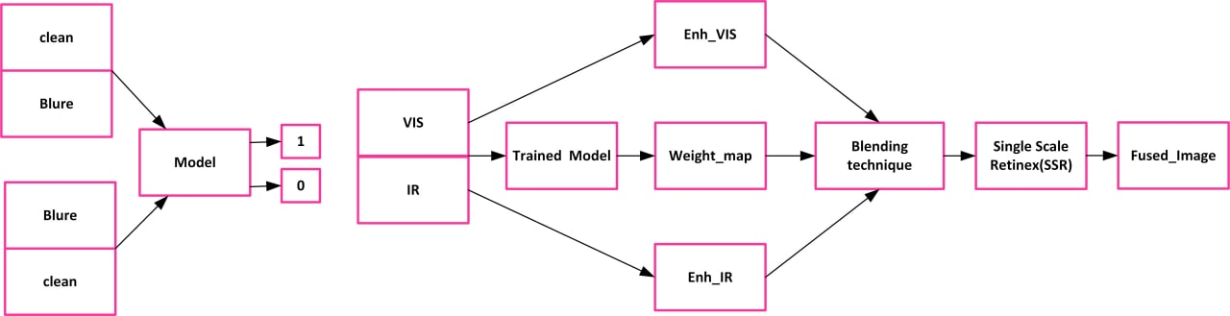
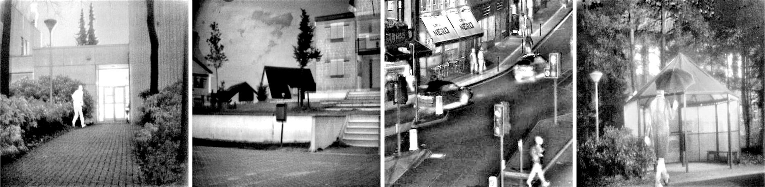
Proposed method
The proposed methodology has three main part:
1, Model Training:
2, Using pre-trained model generate weighted map automatically, according to the salience property of each pixel in source image
3, Fuse weight map with the enhanced infrared and visible Image. Then, finally got fused image
F (r, c) =$\left\{\frac{A \left(r, c\right)\left(W1+S \left(r, c\right)\right)+B \left(r, c\right)\left(W2+S \left(r, c\right)\right)}{2∗S \left(r, c\right) + \sum_{i=1}^{2}{Wi(r,c)}}\right\}$
Where
S (r, c) is weight map
A (r, c) is enhanced visible image
B (r, c) is linear normalized of infrared image,
W1 and W2 are weight maps that come from measuring the distance transformation for a VIS and an IR image, resp

Slide 14
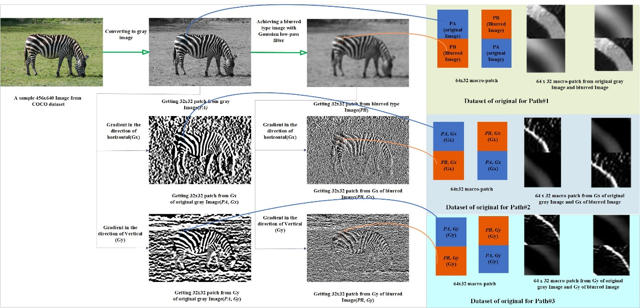
Data preparation
prepared 1000,000 macro-patches for training and 300,000 macro-patches for the test dataset from more than 2200 high-quality images using the procedure shown in figure.
Randomly selected image from COCO dataset is changed to grayscale
Each randomly changed to grayscale image pass through four different Gaussian filters which the standard deviation is 9 and the cut of 9x9,11x11,13x13 and 15x15. Then, produce five different types of images, including the original image and four versions of the blurred version.
The gradient in the direction of horizontal and vertical is applied for both the original and the four version of the blurred version
Create three groups that contain the original image, the gradient in the direction of horizontal (Gx) and the gradient in the direction of vertical (Gy)
Notes:
Originally I used COCO dataset, but to feed to the model, in pre processing

Slide 15
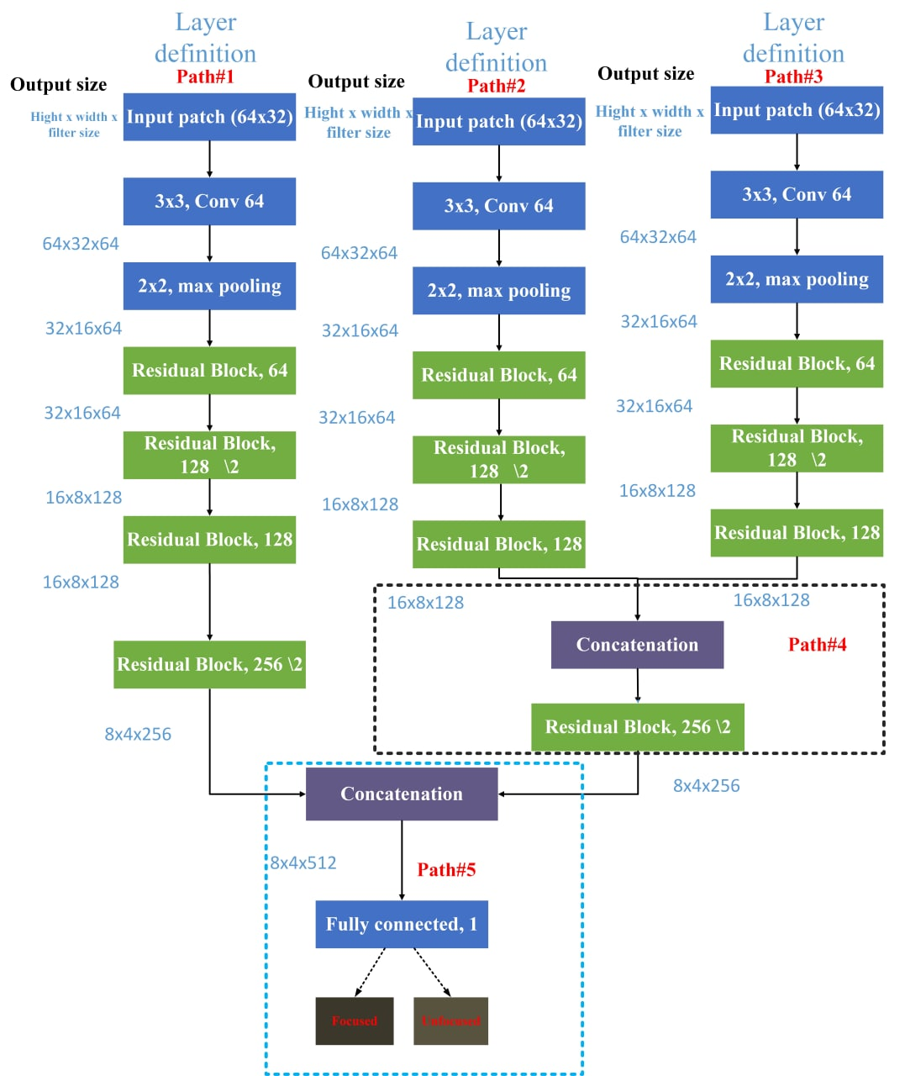
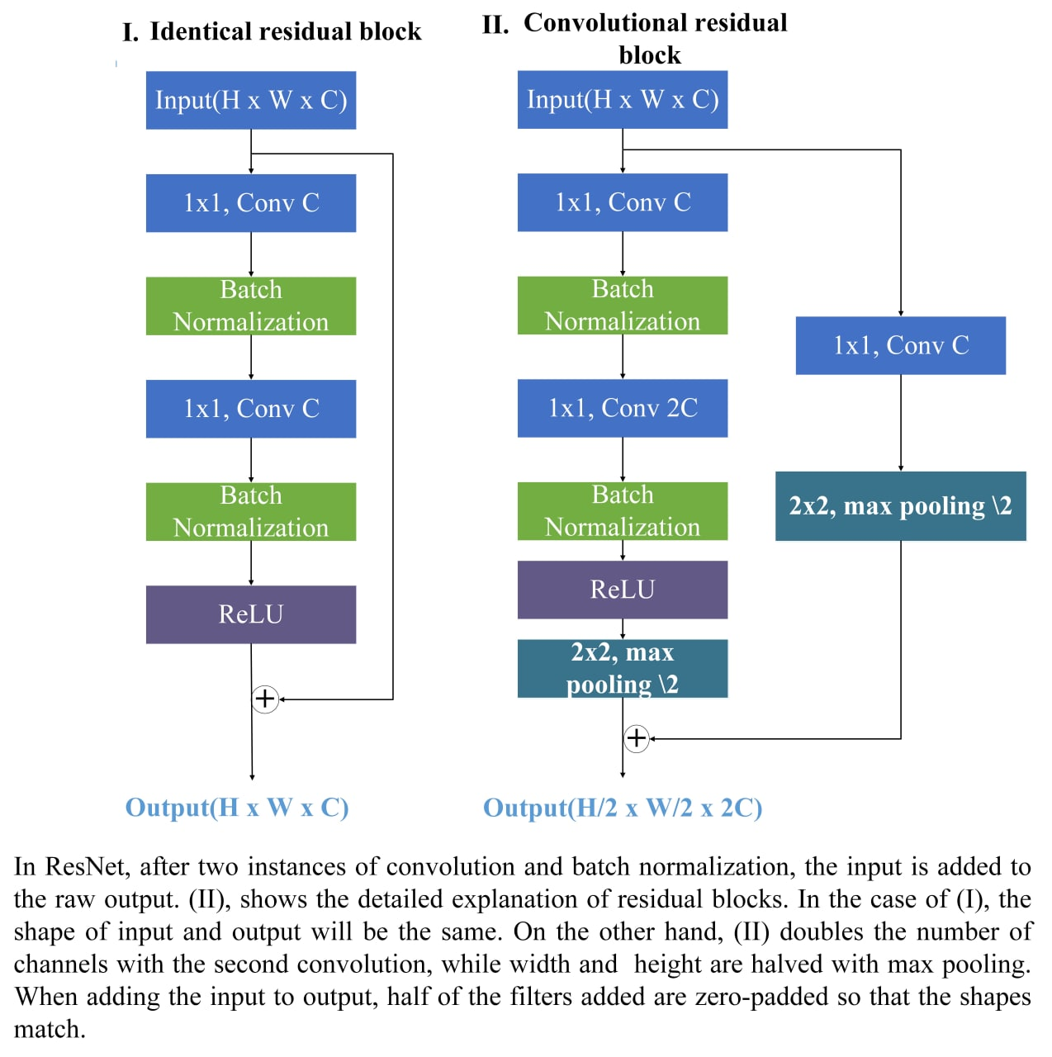
Model Architecture
The original dataset is fed to network in the first path.
The gradient in the directions of horizontal Gx and (the gradient in the directions of vertical )Gy datasets are fed to network in the second and the third paths, respectively.
The outputs of these two paths are concatenated in the fourth path.
After it, the output of the first and the fourth paths are concatenated in the fifth path.
In the fifth path, the FC layer is mapped to the final two neurons for detecting the focused and unfocused
Generally, the model classify focused and unfocused according to input. The input is 64 x32 macro-patch which is concoction of 32x 32 focused and 32x32 unfocused patch

Slide 16
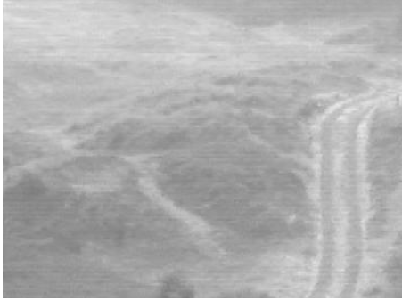
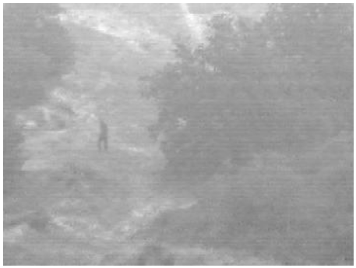
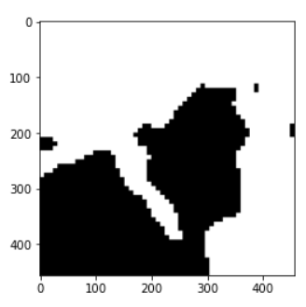
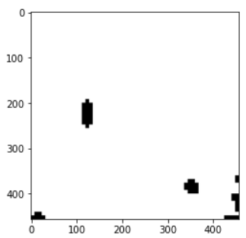
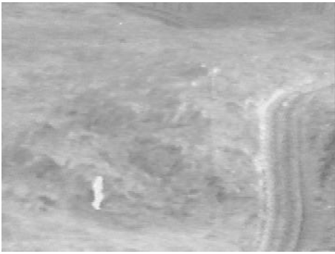
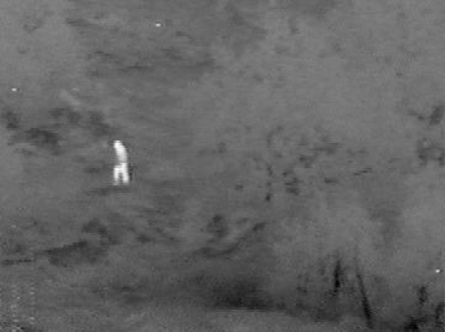
Weighted map generation for IR and VIS image using pre-trained model
Weight map Generation
Weight map Generation
Pre-trained
Pre-trained
Weight map Generation
Weight map Generation
Pre-trained
Pre-trained
Notes:
This ppt slide show that the weight map generation for IR and vis image, the weight map generates according to the silent property of each pixel of inputs.

Slide 17
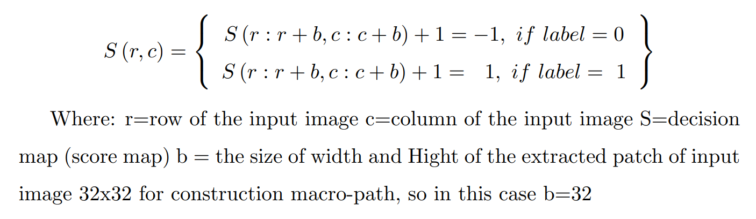
Weight map calculation
Score1=model(block1_1,block1_2,block1_3)
Score2=model(block2_1,block2_2,block3_3)
If score1 <= score2
Label o
If score1 > score2
Label 1

Slide 18
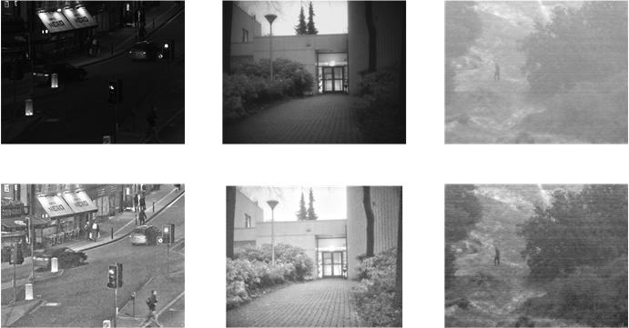
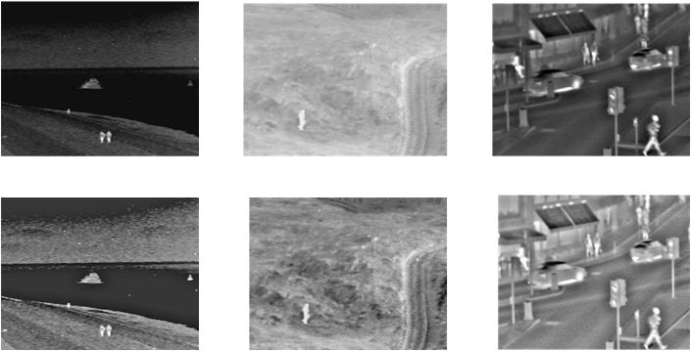
The enhanced infrared and visible Image
To improve the image visibility of poor lighting conditions, we use an HDR (High Dynamic range) compression based on the GF (Guided filter) to adaptively enhance the visible images.
Using linear transform -> enhance IR im
The linear normalization has been done using the minimum and maximum intensity of the image then transform to produces a distribution of values within the range of 0 to 1.

Slide 19
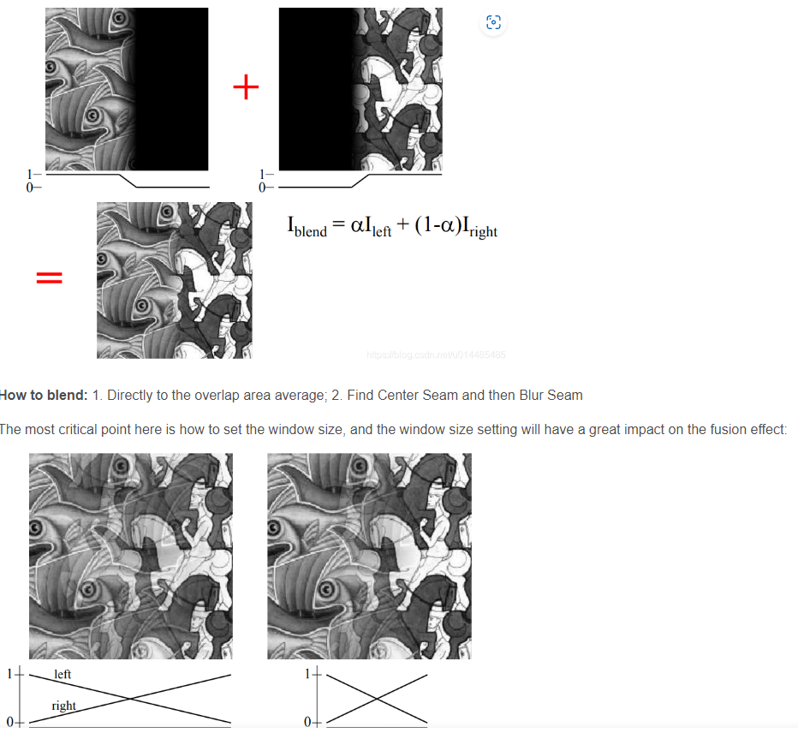
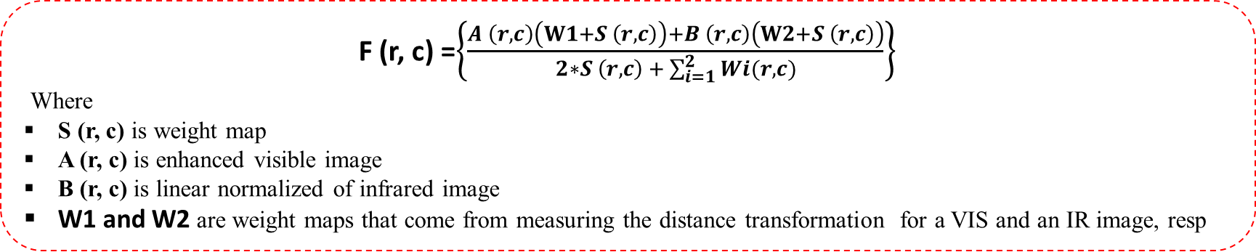
Blending Technique
F (r, c) =$\left\{\frac{A \left(r, c\right)\left(W1+S \left(r, c\right)\right)+B \left(r, c\right)\left(W2+S \left(r, c\right)\right)}{2∗S \left(r, c\right) + \sum_{i=1}^{2}{Wi(r,c)}}\right\}$
Where
S (r, c) is weight map
A (r, c) is enhanced visible image
B (r, c) is linear normalized of infrared image,
W1 and W2 are weight maps that come from measuring the distance transformation for a VIS and an IR image, resp
ndimage.distance_transform_edt()

Slide 20
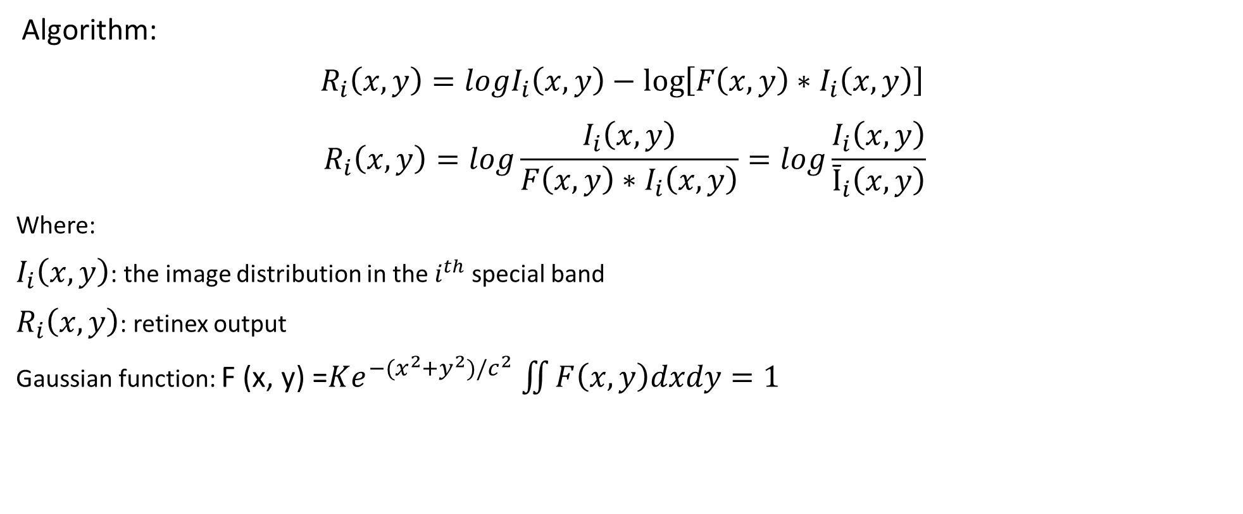
Single Scale Retinex (SSR)
Algorithm:
${ R}_{i}\left(x,y\right)=logI_{i}\left(x,y\right)−\log\left[F\left(x,y\right)∗I_{i}\left(x,y\right)\right]$
$$R_{i}\left(x,y\right)=log\frac{I_{i}\left(x,y\right)}{F\left(x,y\right)∗I_{i}\left(x,y\right)}=log\frac{I_{i}\left(x,y\right)}{Ῑ_{i}\left(x,y\right)}$$
Where:
$I_{i}\left(x,y\right)$: the image distribution in the $i^{th}$ special band
$R_{i}\left(x,y\right)$: retinex output
Gaussian function: F (x, y) =$Ke^{−(x^{2}+y^{2})/c^{2}}$ $\iint{F\left(x,y\right)dxdy=1}$
SSR

Slide 21
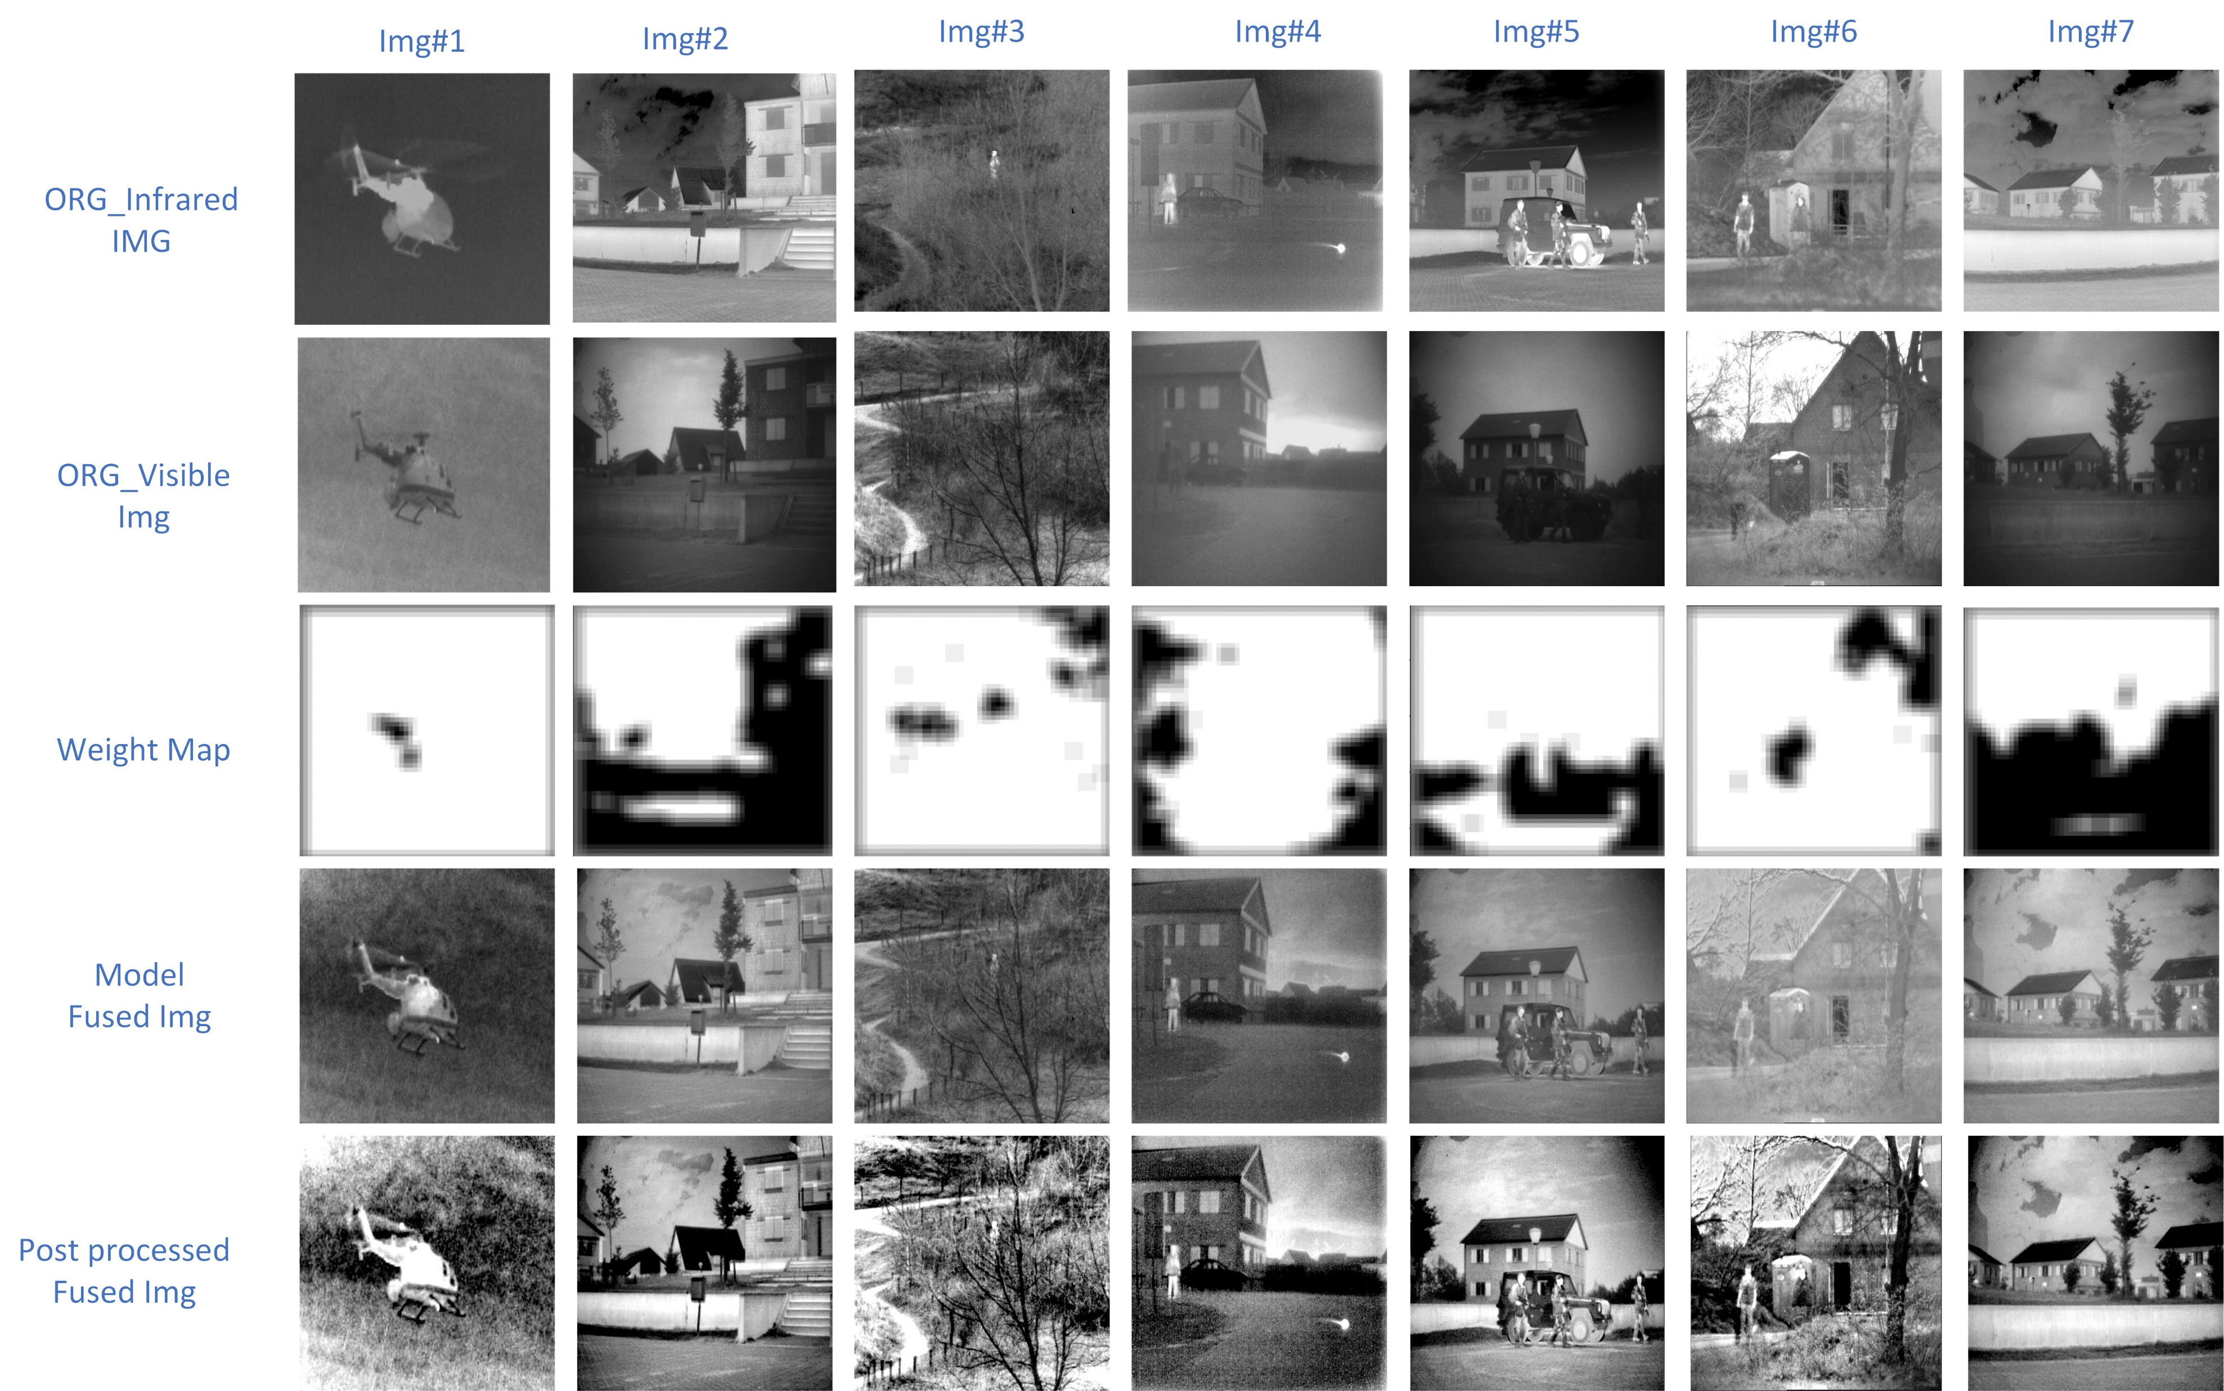
Result
1. VOT2020-RGBT datasets:
The dataset consists 40 pairs of infrared and visible images

Slide 22
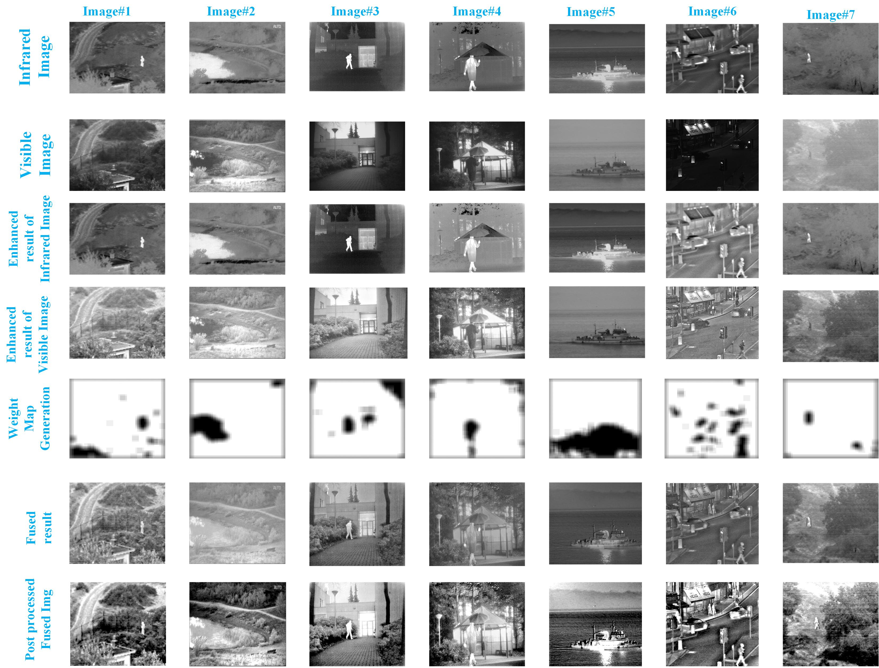
Result
2. TNO datasets:
The dataset consists 21 pairs of infrared and visible images

Slide 23
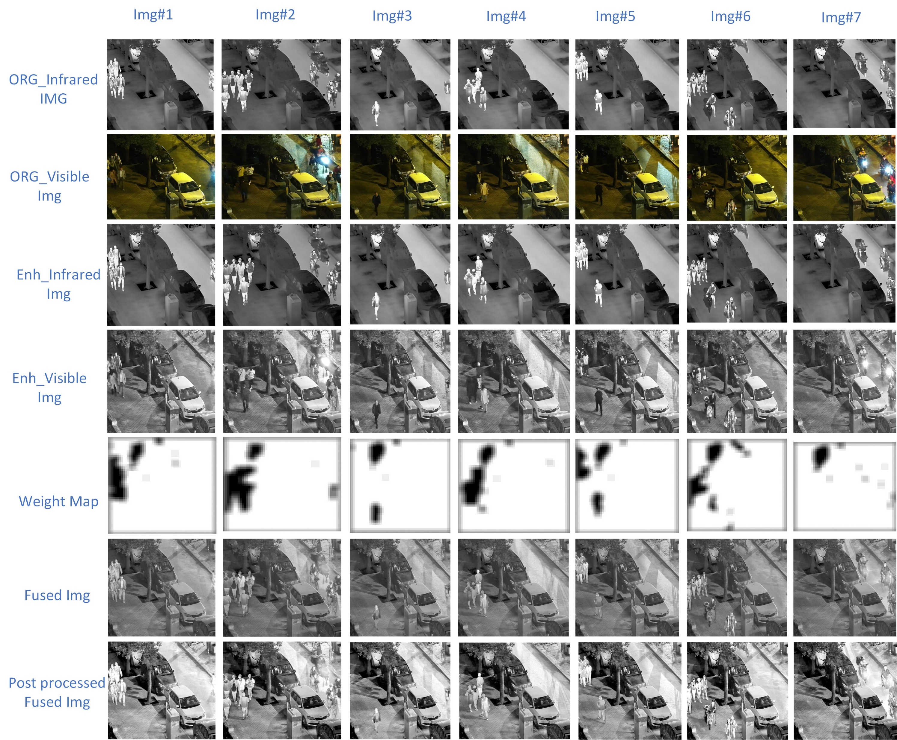
Result
3. LLVIP datasets
The dataset consists 100 pairs of infrared and visible images

Slide 24
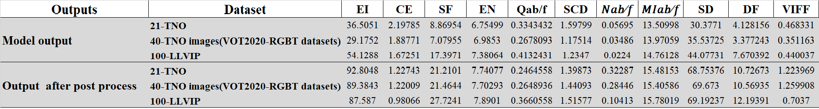
Objective Evaluation
Objective evaluation on three datasets: such as TNO , LLVIP and VOT2020-RGBT. The first dataset consists 21 pairs of infrared and visible images. The second dataset contains 100 pairs of infrared and visible images. The third dataset includes 40 pairs of infrared and visible images
EI and SF determine whether the fusion image extracts more edge and detail information; a high value of EI and SF indicates that the fusion image extracts more edge and detail information
the best value is obtained in EN, indicating that the fused image contains more information.
The best value in the SCD and MI indicates that the fused image retains sufficient information from the source images and is more similar to the source images
The optimum value in VIFF, which indicates that the image is more natural or realistic.
The optimal values of DF and SD indicate that the contrast of fused images is high.
The bad results of Q^{ab/f} and N^{ab/f} mean that the fusion image may have more noise.
The larger the Cross Entropy (CE) value, the greater the information difference between images

Slide 25
Discussion
In this section, using subjective and objective evaluation matrices, we compare the proposed method algorithm with 17 state-of-the-art fusion methods to demonstrate its effectiveness.
Cross Bilateral Filter (CBF), Sparse Convolutional Representation (ConvSR), Structaware, Discrete Cosine Harmonic Wavelet Transform (DCHWT), HybridMSD, DenseFuse, NestFuse, DDcGan, MEF-GAN, Image fusion network based on Proportional Maintenance of Gradient and Intensity (PMGI ),CNN , MDlattLRR, Multi-layer Deep Features Fusion Method (VggML), Image Fusion Framework based on Convolutional Neural Network (IFCNN) (elementwise-maximum), Unified Unsupervised Image Fusion(U2Fusion), ResNet-Zca, and Residual Fusion Network for infrared and visible images(RFN-Nest).
Objective Evaluation metrics
To evaluate the fusion performance objectively, eleven quality metrics are used; such as
Edge Intensity (EI),
SF,
Cross Entropy(CE)
Entropy (EN),
quality of images ($Q^{ab/f}$),
Spatial frequency Sum of Correlation Coefficients (SCD),
noise in images (N^{ab/f}),
Mutual Information between images (M^{Iab/f}),
Standard Deviation of Image (SD),
Definition (DF) and
a novel Visual Information Fidelity (VIFF)
In general, among them, the lower the value of the Cross Entropy and the N^{ab/f}, and the higher the other values, the better the fusion quality of the image.

Slide 26
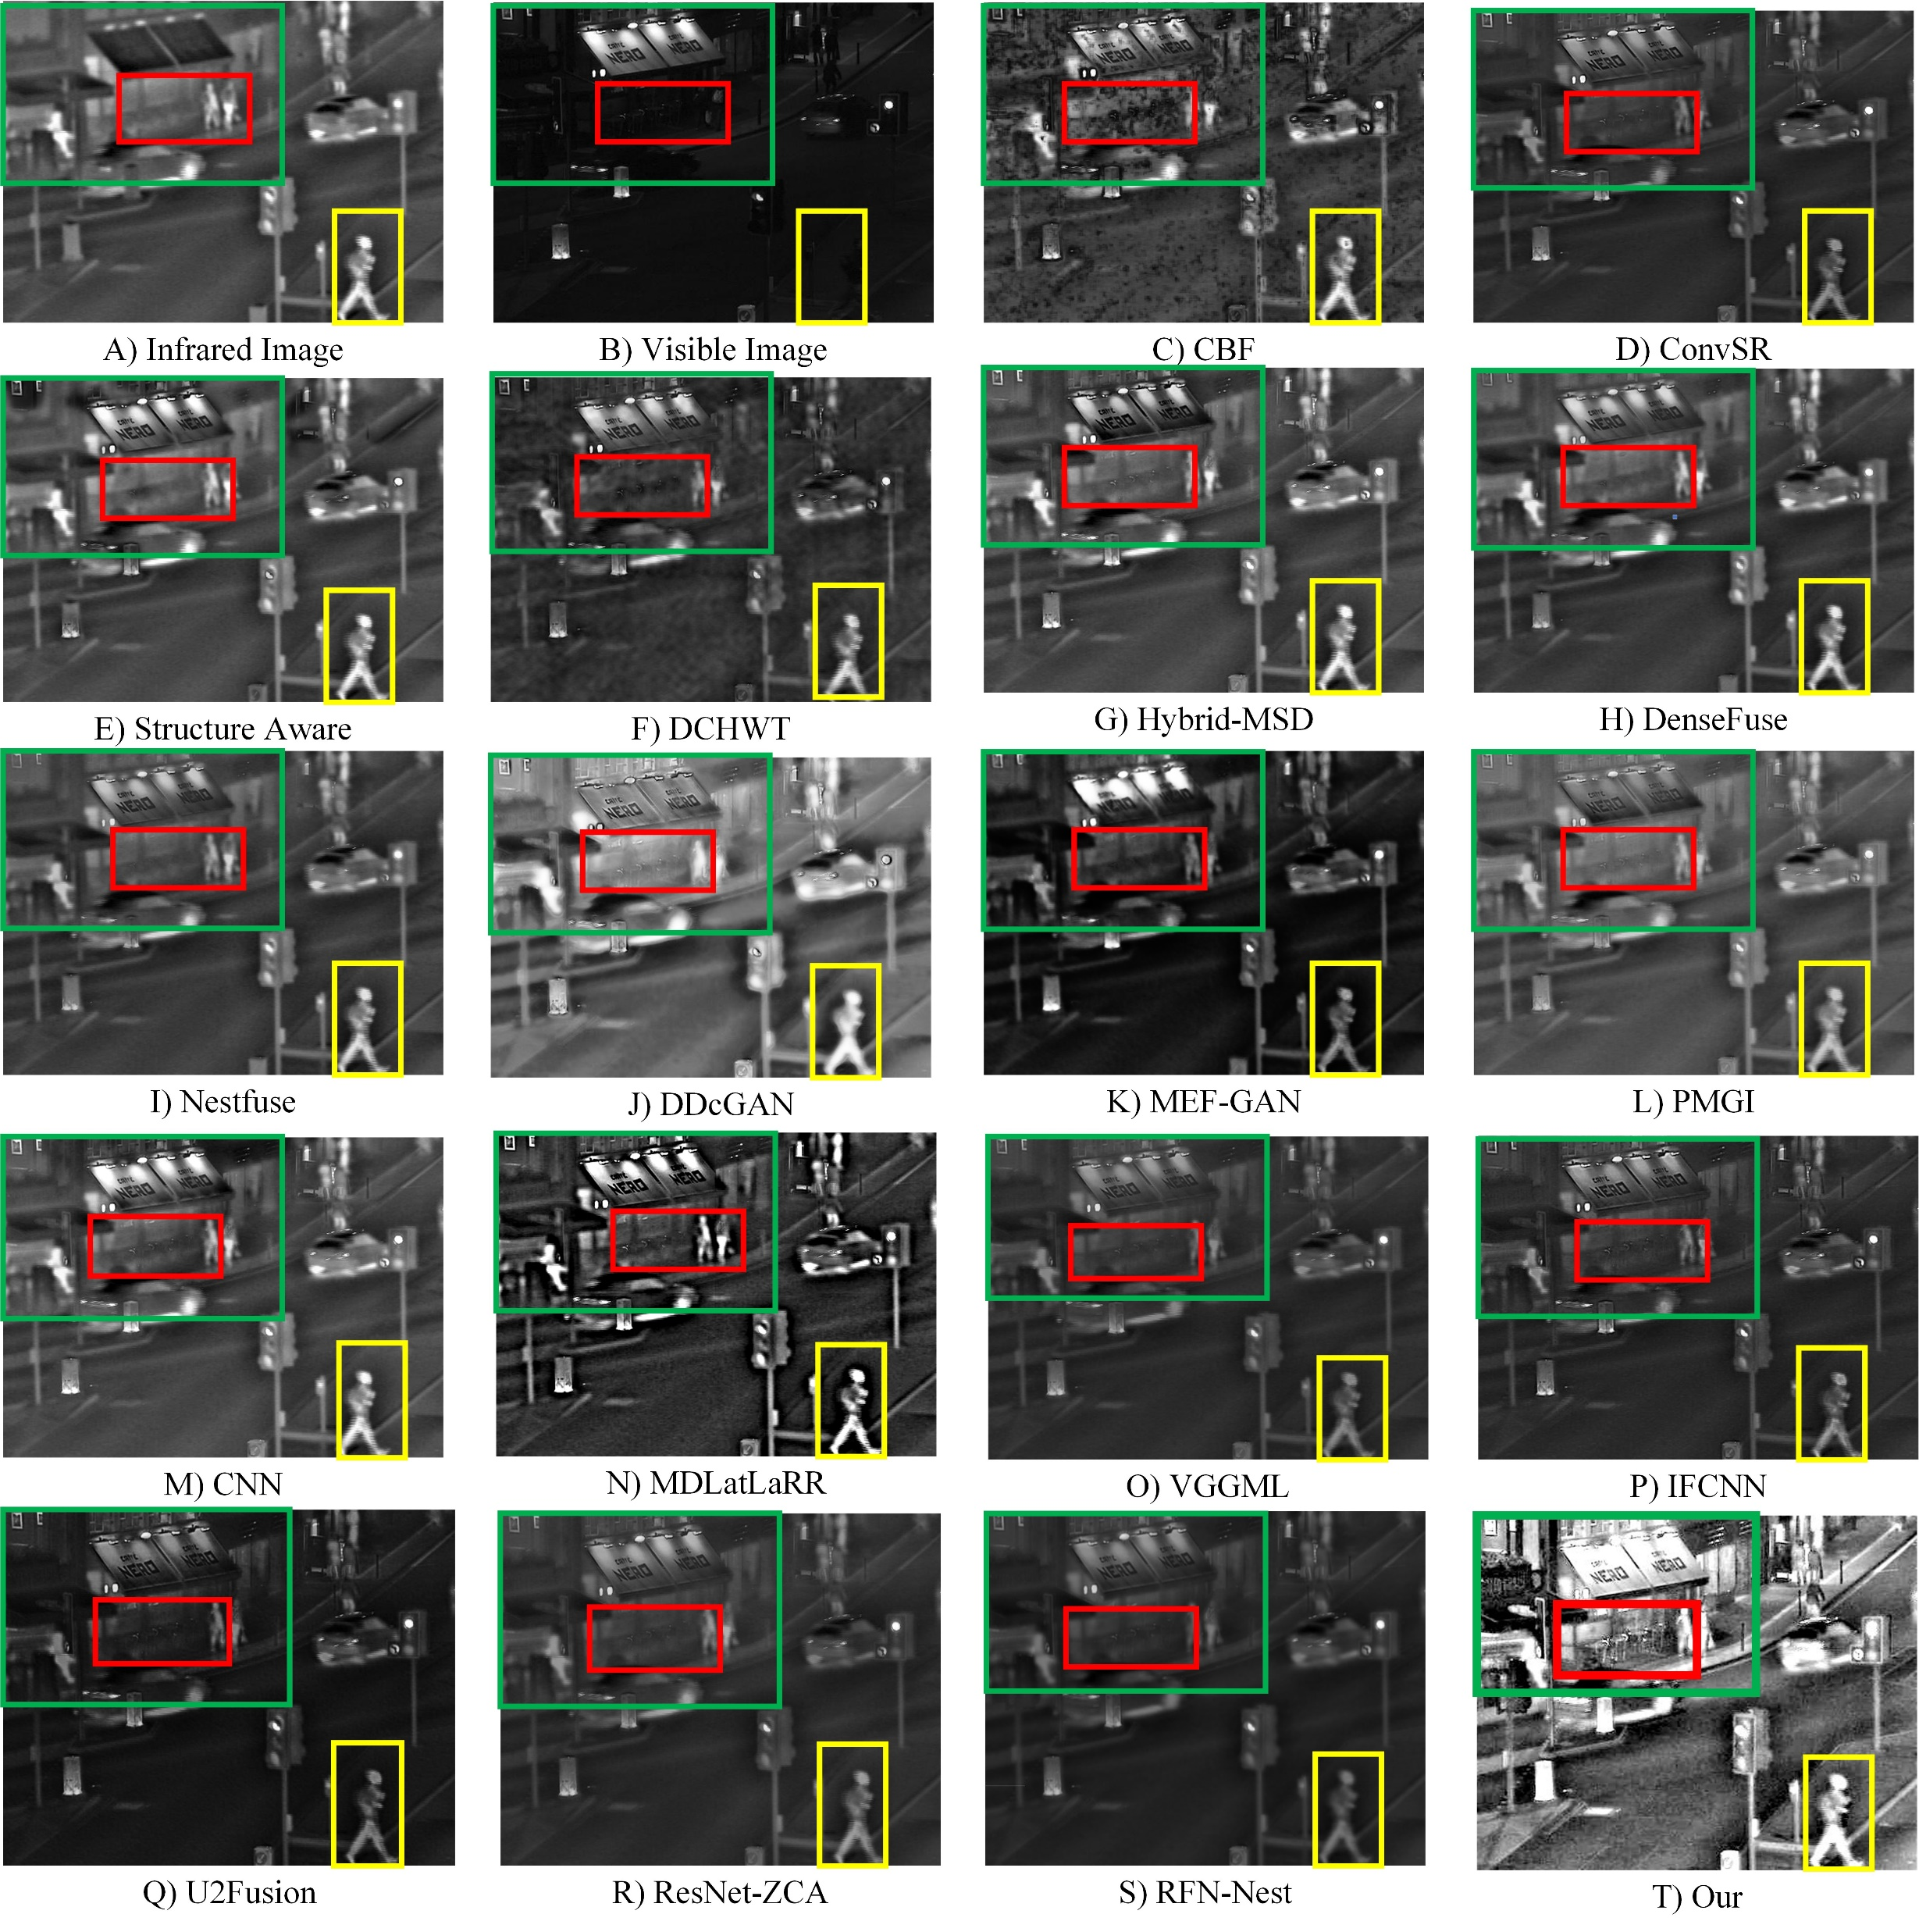
Subjective evaluation

Slide 27
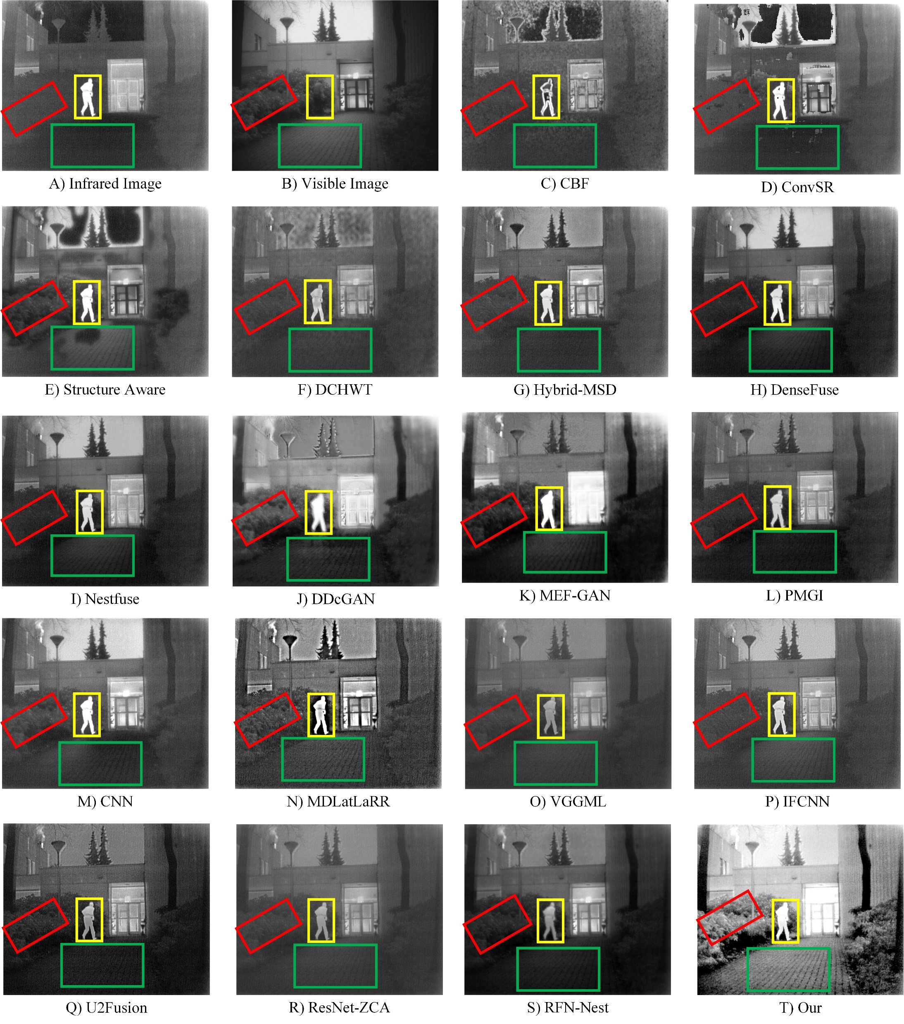
Subjective evaluation

Slide 28
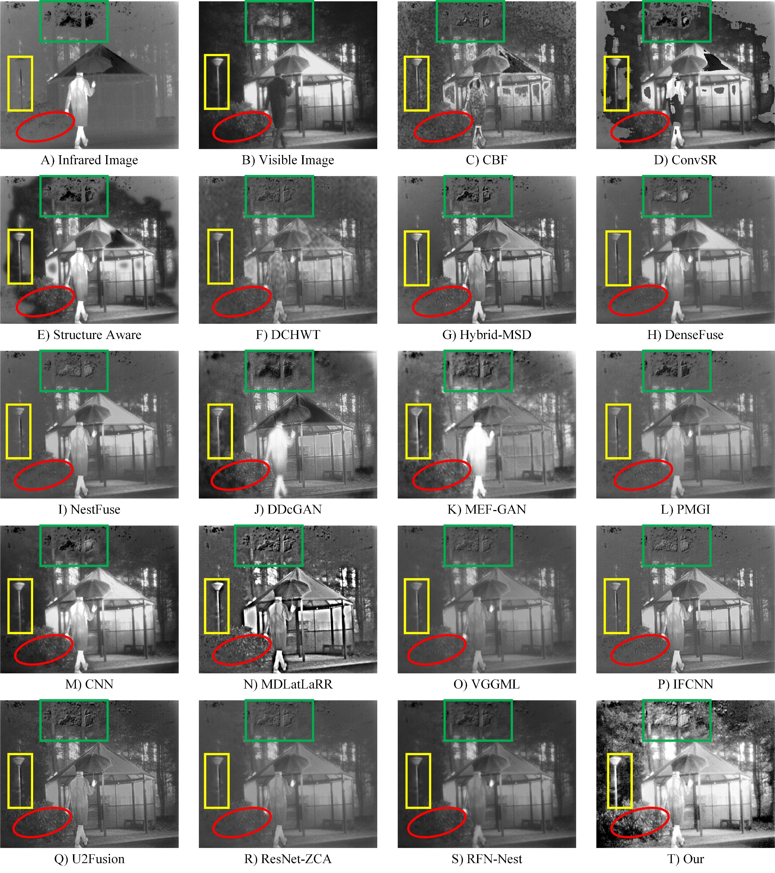
Subjective evaluation

Slide 29
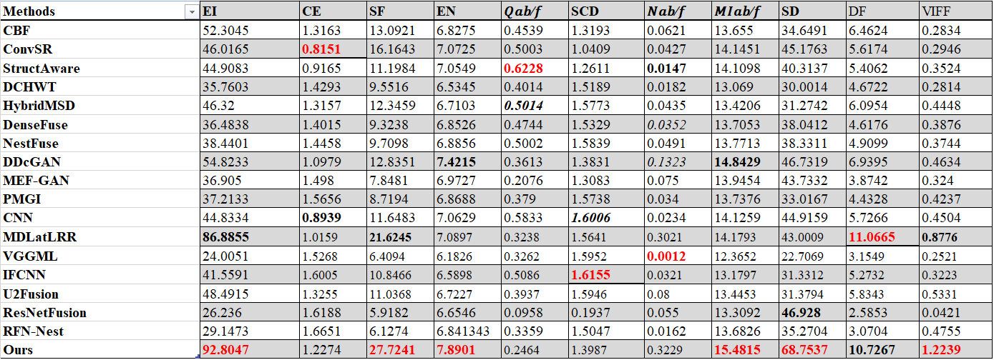
Objective Evaluation
In general, among them, the lower the value of the Cross Entropy and the N^{ab/f}, and the higher the other values, the better the fusion quality of the image.
EI and SF determine whether the fusion image extracts more edge and detail information; a high value of EI and SF indicates that the fusion image extracts more edge and detail information
the best value is obtained in EN, indicating that the fused image contains more information.
The best value in the SCD and MI indicates that the fused image retains sufficient information from the source images and is more similar to the source images
The optimum value in VIFF, which indicates that the image is more natural or realistic.
The optimal values of DF and SD indicate that the contrast of fused images is high.
The bad results of Q^{ab/f} and N^{ab/f} mean that the fusion image may have more noise.
The larger the Cross Entropy (CE) value, the greater the information difference between images

Slide 30
Conclusion
converted IVIF problem into a blur detection problem
designed blur detection multi path deep neural network with siamese and residual structure, using cross domain training methodology to train our proposed network,
combined image enhancement with deep fusion strategy
verified the superior performance of our proposed method extensively in three public datasets comparing it with 17 state-of-the-art methods.

